Slide 1
Module 11: Network Design
Instructor Materials
Enterprise Networking, Security, and Automation v7.0 (ENSA)
Notes:
Cisco Networking Academy Program
Enterprise Networking, Security, and Automation v7.0 (ENSA)
Module 11: Network Design

Slide 2
Instructor Materials – Module 11 Planning Guide
This PowerPoint deck is divided in two parts:
Instructor Planning Guide
  Information to help you become familiar with the module
  Teaching aids
Instructor Class Presentation
  Optional slides that you can use in the classroom
  Begins on slide # 9
  Note: Remove the Planning Guide from this presentation before sharing with anyone.
For additional help and resources go to the Instructor Home Page and Course Resources for this course. You also can visit the professional development site on netacad.com, the official Cisco Networking Academy Facebook page, or Instructor Only FB group.
Notes:
2

Slide 3
What to Expect in this Module
To facilitate learning, the following features within the GUI may be included in this module:
Feature | Description
Animations | Expose learners to new skills and concepts.
Videos | Expose learners to new skills and concepts.
Check Your Understanding(CYU) | Per topic online quiz to help learners gauge content understanding.
Interactive Activities | A variety of formats to help learners gauge content understanding.
Syntax Checker | Small simulations that expose learners to Cisco command line to practice configuration skills.
PT Activity | Simulation and modeling activities designed to explore, acquire, reinforce, and expand skills.

Slide 4
What to Expect in this Module (Cont.)
To facilitate learning, the following features may be included in this module:
Feature | Description
Hands-On Labs | Labs designed for working with physical equipment.
Class Activities | These are found on the Instructor Resources page. Class Activities are designed to facilitate learning, class discussion, and collaboration.
Module Quizzes | Self-assessments that integrate concepts and skills learned throughout the series of topics presented in the module.
Module Summary | Briefly recaps module content.

Slide 5
Check Your Understanding
Check Your Understanding activities are designed to let students quickly determine if they understand the content and can proceed, or if they need to review.
Check Your Understanding activities do not affect student grades.
There are no separate slides for these activities in the PPT. They are listed in the notes area of the slide that appears before these activities.
Notes:
5

Slide 6
Module 11: Activities
What activities are associated with this module?
Page # | Activity Type | Activity Name | Optional?
11.1.1 | Video | Three-Layer Network design | Recommended
11.1.8 | Check Your Understanding | Hierarchical Networks | Recommended
11.2.7 | Check Your Understanding | Scalable Networks | Recommended
11.3.8 | Check Your Understanding | Switch Hardware | Recommended
11.4.4 | Check Your Understanding | Router Hardware | Recommended
11.5.1 | Packet Tracer | Compare Layer 2 and Layer 3 Devices | Recommended
11.5.3 | Module Quiz | Network Design | Recommended
Notes:
6

Slide 7
Module 11: Best Practices
Prior to teaching Module 11, the instructor should:
Review the activities and assessments for this module.
Try to include as many questions as possible to keep students engaged during classroom presentation.
Topic 11.1
  Ask the students or have a class discussion
    What would make it easier to design a brand new network?
    Would you let your users use their own devices on a corporate network?
Topic 11.2
  Ask the students or have a class discussion
    What could you do to make sure the network is resilient and scalable?
Notes:
7

Slide 8
Module 11: Best Practices (Cont.)
Topic 11.3
  Ask the students or have a class discussion
    What kind a switch do you need to connect users in a classroom?
    What kind of switch is used in a data center?
Topic 11.4
  Ask the students or have a class discussion
    What kind a router do you need to connect a small branch to the corporate network?
    What kind of router is used by a service provider?
Notes:
8

Slide 9
Module 11: Network Design
Enterprise Networking, Security, and Automation v7.0 (ENSA)
Notes:
Cisco Networking Academy Program
Enterprise Networking, Security, and Automation v7.0 (ENSA)
Module 11: Network Design

Slide 10
Module Objectives
Module Title: Network Design
Module Objective: Explain the characteristics of scalable network architectures.
Topic Title | Topic Objective
Hierarchical Networks | Explain how data, voice, and video are converged in a switched network.
Scalable Networks | Explain considerations for designing a scalable network.
Switch Hardware | Explain how switch hardware features support network requirements.
Router Hardware | Describe the types of routers available for small to-medium-sized business networks.
Notes:
10
11 – Network Design
11.0 – Introduction
11.0.2 – What will I learn to do in this module?

Slide 11
11.1 Hierarchical Networks
Notes:
11 – Network Design
11.1 – Hierarchical Networks

Slide 12
Hierarchical Networks
Video - Three-Layer Network Design
This video will demonstrate a three-layer model in network design.
Notes:
11 – Network Design
11.1 – Hierarchical Networks
11.1.1 – Video - Three-Layer Network Design

Slide 13
Hierarchical Networks
The Need to Scale the Network
Organizations increasingly rely on their network infrastructure to provide mission-critical services.
Evolving organizations require networks that can scale and support:
  Converged network traffic
  Critical applications
  Diverse business needs
  Centralized administrative control
Campus network designs include small networks that use a single LAN switch, up to very large networks with thousands of connections.
Notes:
11 – Network Design
11.1 – Hierarchical Networks
11.1.2 – The Need to Scale the Network

Slide 14
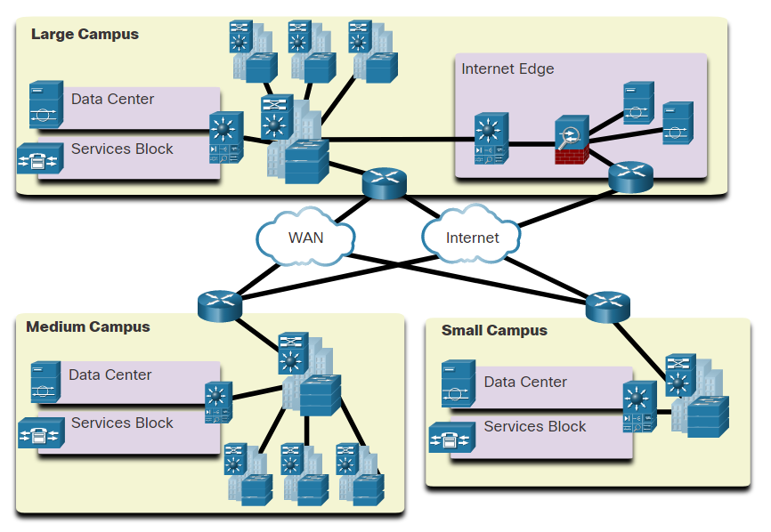
Hierarchical Networks
Borderless Switched Networks
The Cisco Borderless Network is a network architecture that can connect anyone, anywhere, anytime, on any device; securely, reliably, and seamlessly.
It provides the framework to unify wired and wireless access, built on a hierarchical infrastructure of hardware that is scalable and resilient.
Borderless switched networks are hierarchical, modular, resilient, and flexible.
Notes:
11 – Network Design
11.1 – Hierarchical Networks
11.1.3 – Borderless Switched Networks

Slide 15
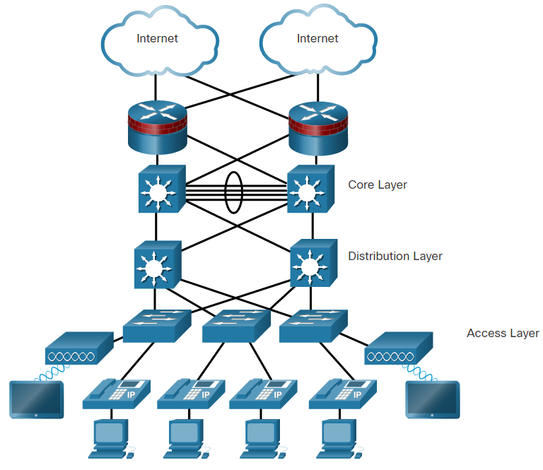
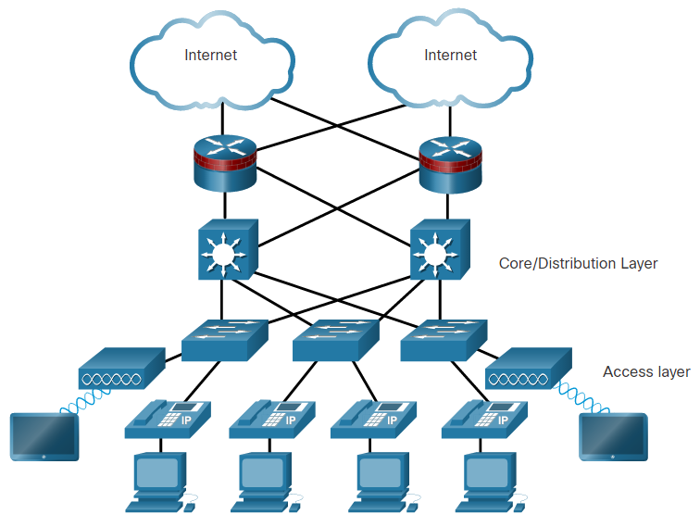
Hierarchical Networks
Hierarchy in the Borderless Switched Network
  Hierarchical networks use a tiered design of access, distribution, and core layers with each layer performing a well-defined role in the campus network.
  There are two time-tested and proven hierarchical design frameworks for campus networks.
Three-tier layer
Two-tier layer
Notes:
11 – Network Design
11.1 – Hierarchical Networks
11.1.4 – Hierarchy in the Borderless Switched Network

Slide 16
Hierarchical Networks
Access, Distribution, and Core Layer Functions
Access Layer
The access layer provide network access to the user.
Access layer switches connect to distribution layer switches.
Distribution Layer
The distribution layer implements routing, quality of service, and security.
It aggregates large-scale wiring closet networks and limits Layer 2 broadcast domains.
Distribution layer switches connect to access layer and core layer switches.
Core Layer
The core layer is the network backbone and connects several layers of the network.
The core layer provides fault isolation and high-speed backbone connectivity.
Notes:
11 – Network Design
11.1 – Hierarchical Networks
11.1.5 – Access, Distribution, and Core Layer Functions

Slide 17
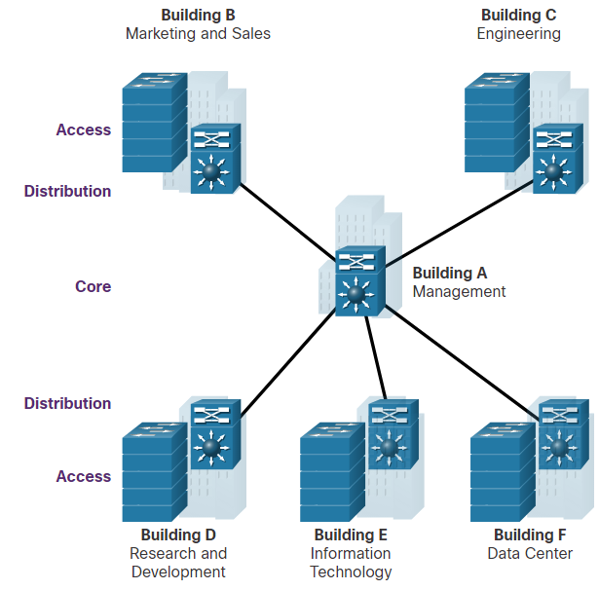
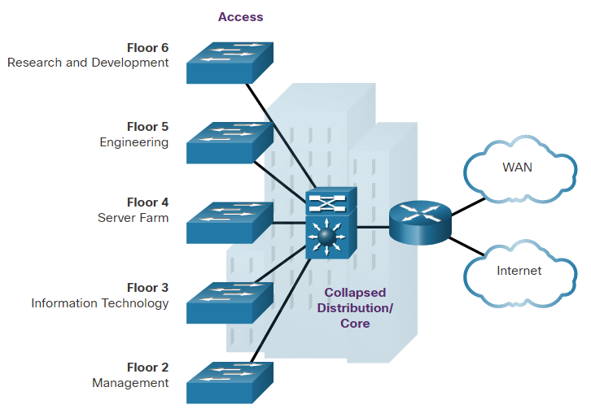
Hierarchical Networks
Three-Tier and Two-Tier Examples
Three-tier Campus Network
Used by organizations requiring access, distribution, and core layers.
The recommendation is to build an extended-star physical network topology from a centralized building location to all other buildings on the same campus.
Two-tier Campus Network
Used when separate distribution and core layers is not required.
Useful for smaller campus locations, or in campus sites consisting of a single building.
Also known as the collapsed core network design.
Notes:
11 – Network Design
11.1 – Hierarchical Networks
11.1.6 – Three-Tier and Two-Tier Examples

Slide 18
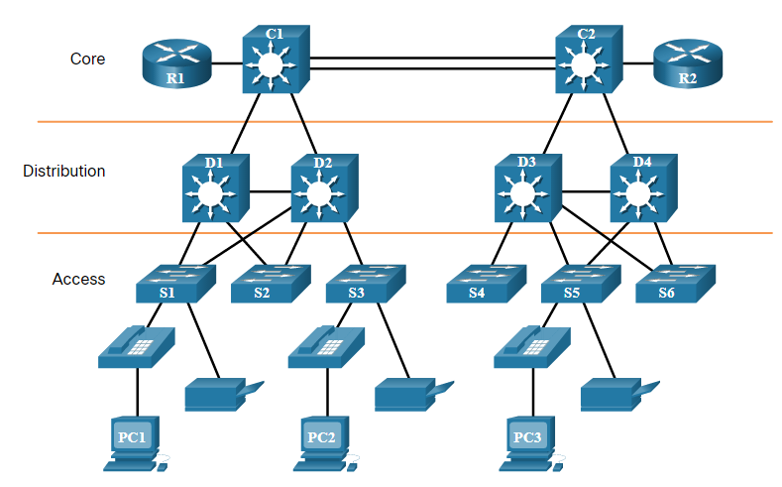
Hierarchical Networks
Role of Switched Networks
Networks have fundamentally changed from a flat network of hubs to switched LANs in a hierarchical network.
A switched LAN allows additional flexibility, traffic management, quality of service, security.
A switched LAN may also support wireless networking and other technologies such as IP telephone and mobility services.
Notes:
11 – Network Design
11.1 – Hierarchical Networks
11.1.7 – Role of Switched Networks
11.1.8 – Check Your Understanding - Hierarchical Networks

Slide 19
11.2 Scalable Networks
Notes:
11 – Network Design
11.2 – Scalable Networks

Slide 20
Scalable Networks
Design for Scalability
Scalability is the term for a network that can grow without losing availability and reliability.
Network designers must develop strategies to enable the network to be available and to scale effectively and easily.
This is accomplished using:
Redundancy
Multiple Links
Scalable Routing protocol
Wireless Connectivity
Notes:
11 – Network Design
11.2 – Scalable Networks
11.2.1 – Design for Scalability

Slide 21
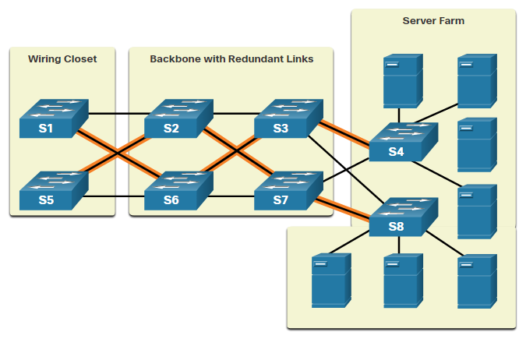
Scalable Networks
Plan for Redundancy
Redundancy can prevent disruption of network services by minimizing the possibility of a single point of failure by:
Installing duplicate equipment
Providing failover services for critical devices
Redundant paths offer alternate physical paths for data to traverse the network supporting high availability.
However, redundant paths in an Ethernet network may cause logical Layer 2 loops.
Therefore, Spanning Tree Protocol (STP) is required.
Notes:
11 – Network Design
11.2 – Scalable Networks
11.2.2 – Plan for Redundancy

Slide 22
Scalable Networks
Reduce Failure Domain Size
A well-designed network controls traffic and limits the size of failure domains (i.e., the area of a network that is impacted when the network experiences problems).
In the hierarchical design model, failure domains are terminated at the distribution layer.
Every router functions as a gateway for a limited number of access layer users.
Routers, or multilayer switches, are usually deployed in pairs in a configuration referred to as a building, or departmental, switch block.
Each switch block acts independently of the others.
As a result, the failure of a single device does not cause the network to go down.
Notes:
11 – Network Design
11.2 – Scalable Networks
11.2.3 – Reduce Failure Domain Size

Slide 23
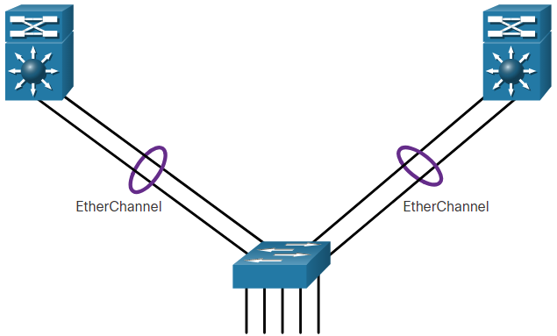
Scalable Networks
Increase Bandwidth
Link aggregation (e.g., EtherChannel) allows an administrator to increase the amount of bandwidth between devices by creating one logical link made up of several physical links.
EtherChannel combines existing switch ports into one logical link using a Port Channel interface.
Most configuration tasks are done on the Port Channel interface (instead of on each individual port) to ensure configuration consistency on the links.
EtherChannel can load balance between links.
Notes:
11 – Network Design
11.2 – Scalable Networks
11.2.4 – Increase Bandwidth

Slide 24
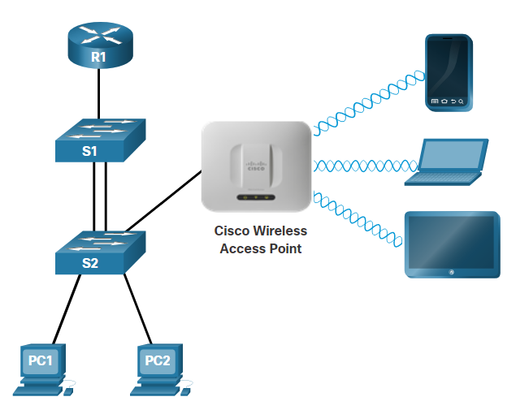
Scalable Networks
Expand the Access Layer
An increasingly popular option for extending access layer connectivity is through wireless.
Wireless LANs (WLANs) provides increased flexibility, reduced costs, and the ability to grow and adapt to changing network and business requirements.
  To communicate wirelessly, end devices require a wireless NIC to connect to a wireless router or a wireless access point (AP).
  Considerations when implementing a wireless network include:
  Types of wireless devices connecting to the WLAN
  Wireless coverage requirements
  Interference considerations
  Security considerations
Notes:
11 – Network Design
11.2 – Scalable Networks
11.2.5 – Expand the Access Layer

Slide 25
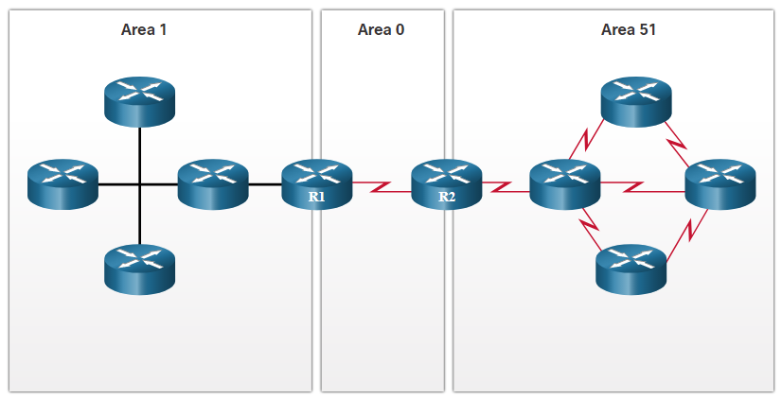
Scalable Networks
Tune Routing Protocols
Advanced routing protocols, such as Open Shortest Path First (OSPF) are used in large networks.
OSPF is a link-state routing protocol that uses areas to support a hierarchical networks.
OSPF routers establish and maintain neighbor adjacencies with other connected OSPF routers.
OSPF routers synchronize their link-state database.
When a network change occurs, link-state updates are sent, informing other OSPF routers of the change and establishing a new best path, if one is available.
Notes:
11 – Network Design
11.2 – Scalable Networks
11.2.6 – Tune Routing Protocols
11.2.7 – Check Your Understanding - Scalable Networks

Slide 26
11.3 Switch Hardware
Notes:
11 – Network Design
11.3 – Switch Hardware

Slide 27
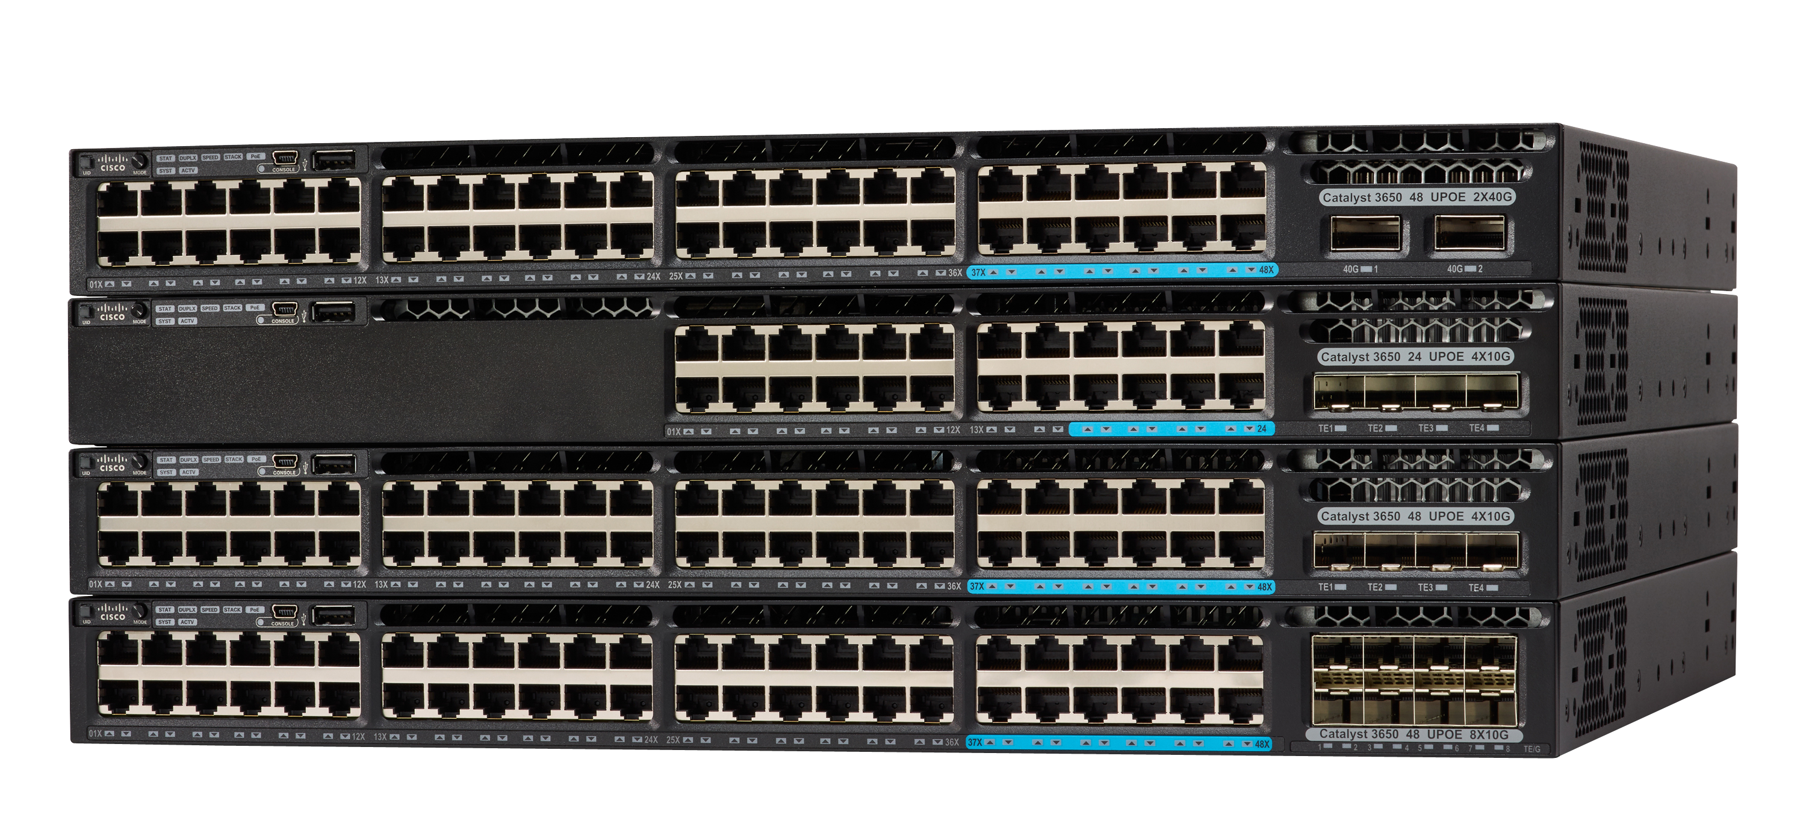
Switch Hardware
Switch Platforms
There is a variety of switch platforms, form factors, and other features that must be considered before choosing a switch. When designing a network, it is important to select the proper hardware to meet current network requirements, as well as to allow for network growth. Within an enterprise network, both switches and routers play a critical role in network communication.
Campus LAN Switches, such as the Cisco 3850 series shown here, support high concentrations of user connections with speed and security appropriate for the enterprise network.
Notes:
11 – Network Design
11.3 – Switch Hardware
11.3.1 – Switch Platforms

Slide 28
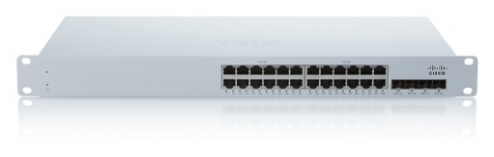
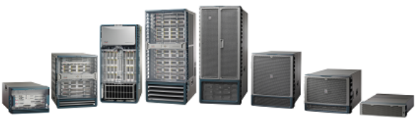
Switch Hardware
Switch Platforms (Cont.)
Cisco Meraki cloud-managed access switches enable virtual stacking of switches. They monitor and configure thousands of switch ports over the web, without the intervention of onsite IT staff.
The Cisco Nexus platform promotes infrastructure scalability, operational continuity, and transport flexibility in the data center.
Notes:
11 – Network Design
11.3 – Switch Hardware (Cont.)
11.3.1 – Switch Platforms

Slide 29
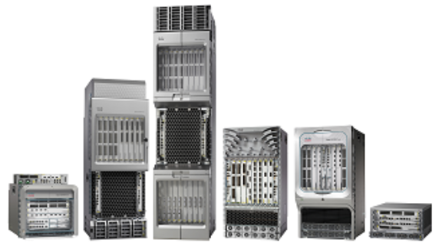

Switch Hardware
Switch Platforms (Cont.)
Service provider Ethernet access switches feature application intelligence, unified services, virtualization, integrated security, and simplified management.
Cisco Nexus virtual networking switch platforms provide secure multi-tenant services by adding virtualization intelligence technology to the data center network.
Notes:
11 – Network Design
11.3 – Switch Hardware (Cont.)
11.3.1 – Switch Platforms

Slide 30
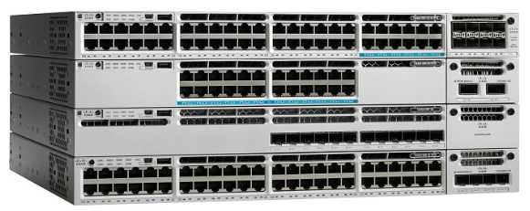
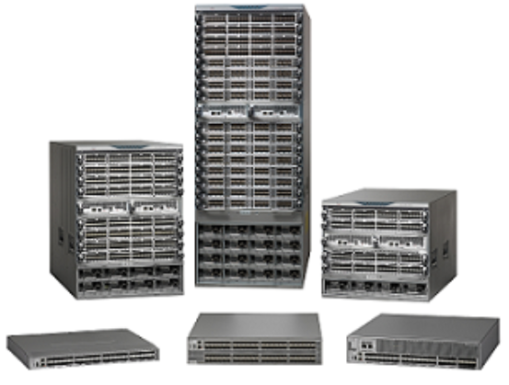
Switch Hardware
Switch Form Factors
When selecting switches, network administrators must determine the switch form factors. This includes fixed configuration, modular configuration, stackable, or non-stackable.
Features and options on fixed configuration switches are limited to those that originally come with the switch.
The chassis on modular switches accept field-replaceable line cards.
Notes:
11 – Network Design
11.3 – Switch Hardware
11.3.2 – Switch Form Factors

Slide 31
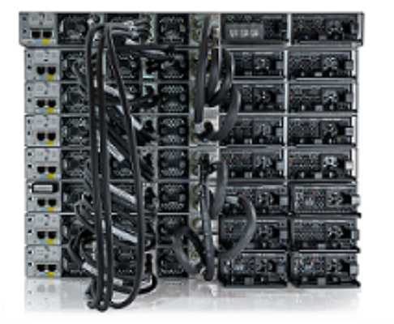
Switch Hardware
Switch Form Factors (Cont.)
Special cables are used to connect stackable switches that allow them to effectively operate as one large switch.
The thickness of the switch, which is expressed in the number of rack units, is also important for switches that are mounted in a rack. For example, the fixed configuration switches shown in the figure are all one rack units (1U) or 1.75 inches (44.45 mm) in height.
Notes:
11 – Network Design
11.3 – Switch Hardware
11.3.2 – Switch Form Factors (Cont.)

Slide 32
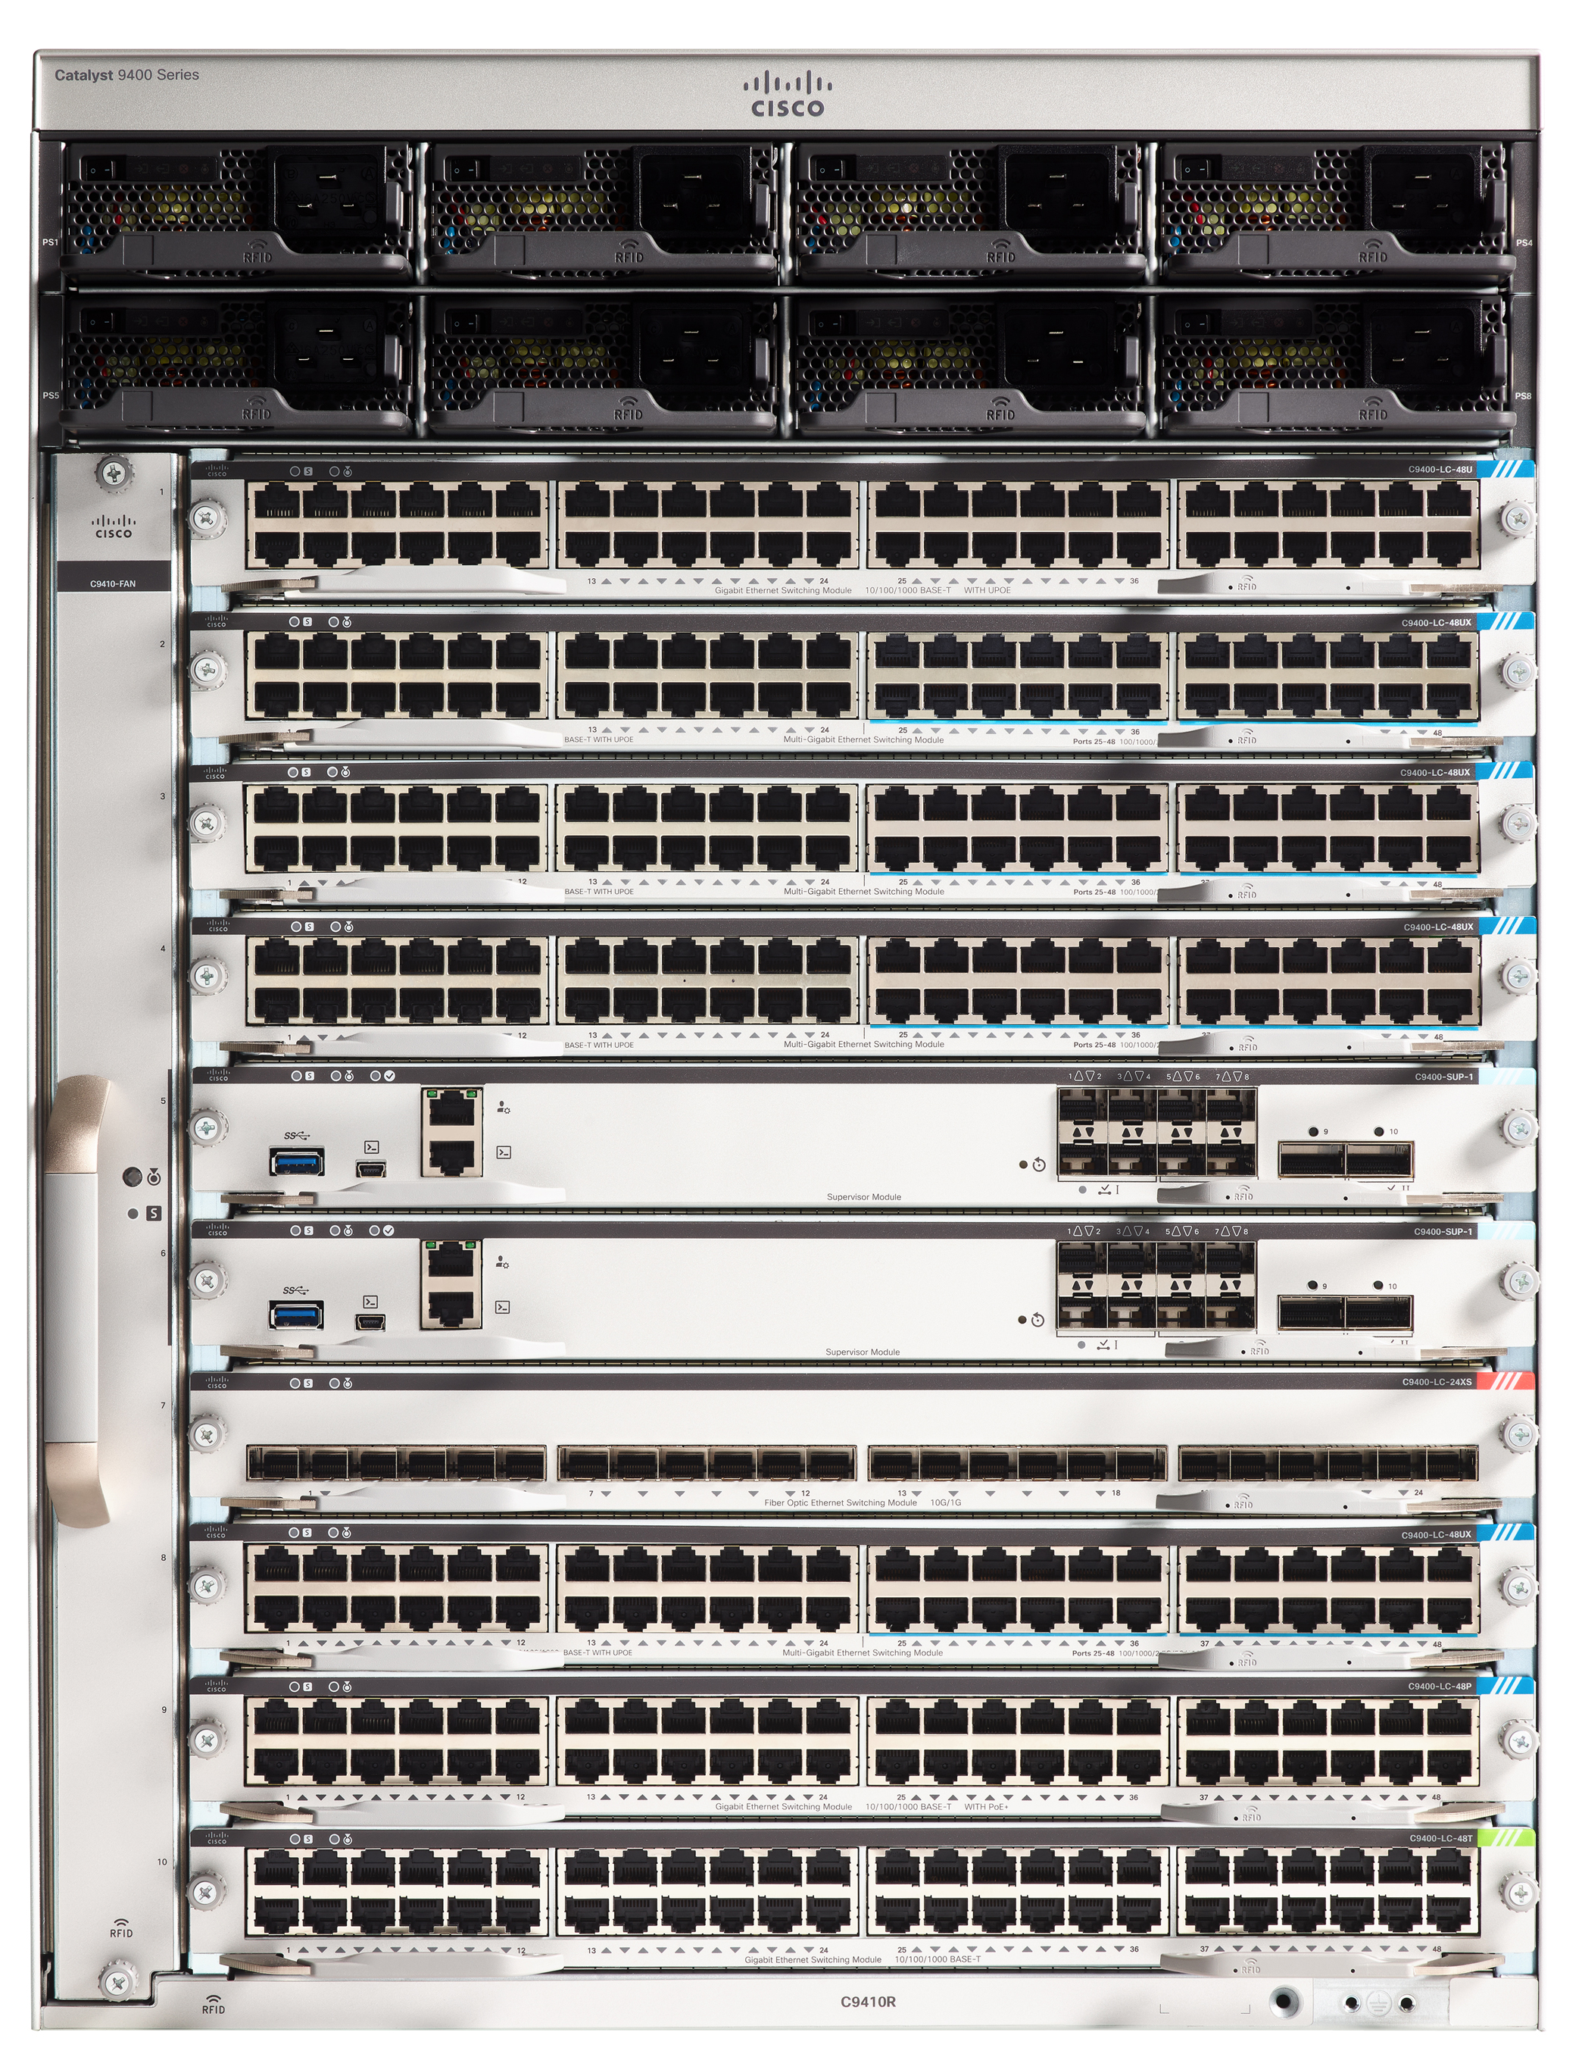
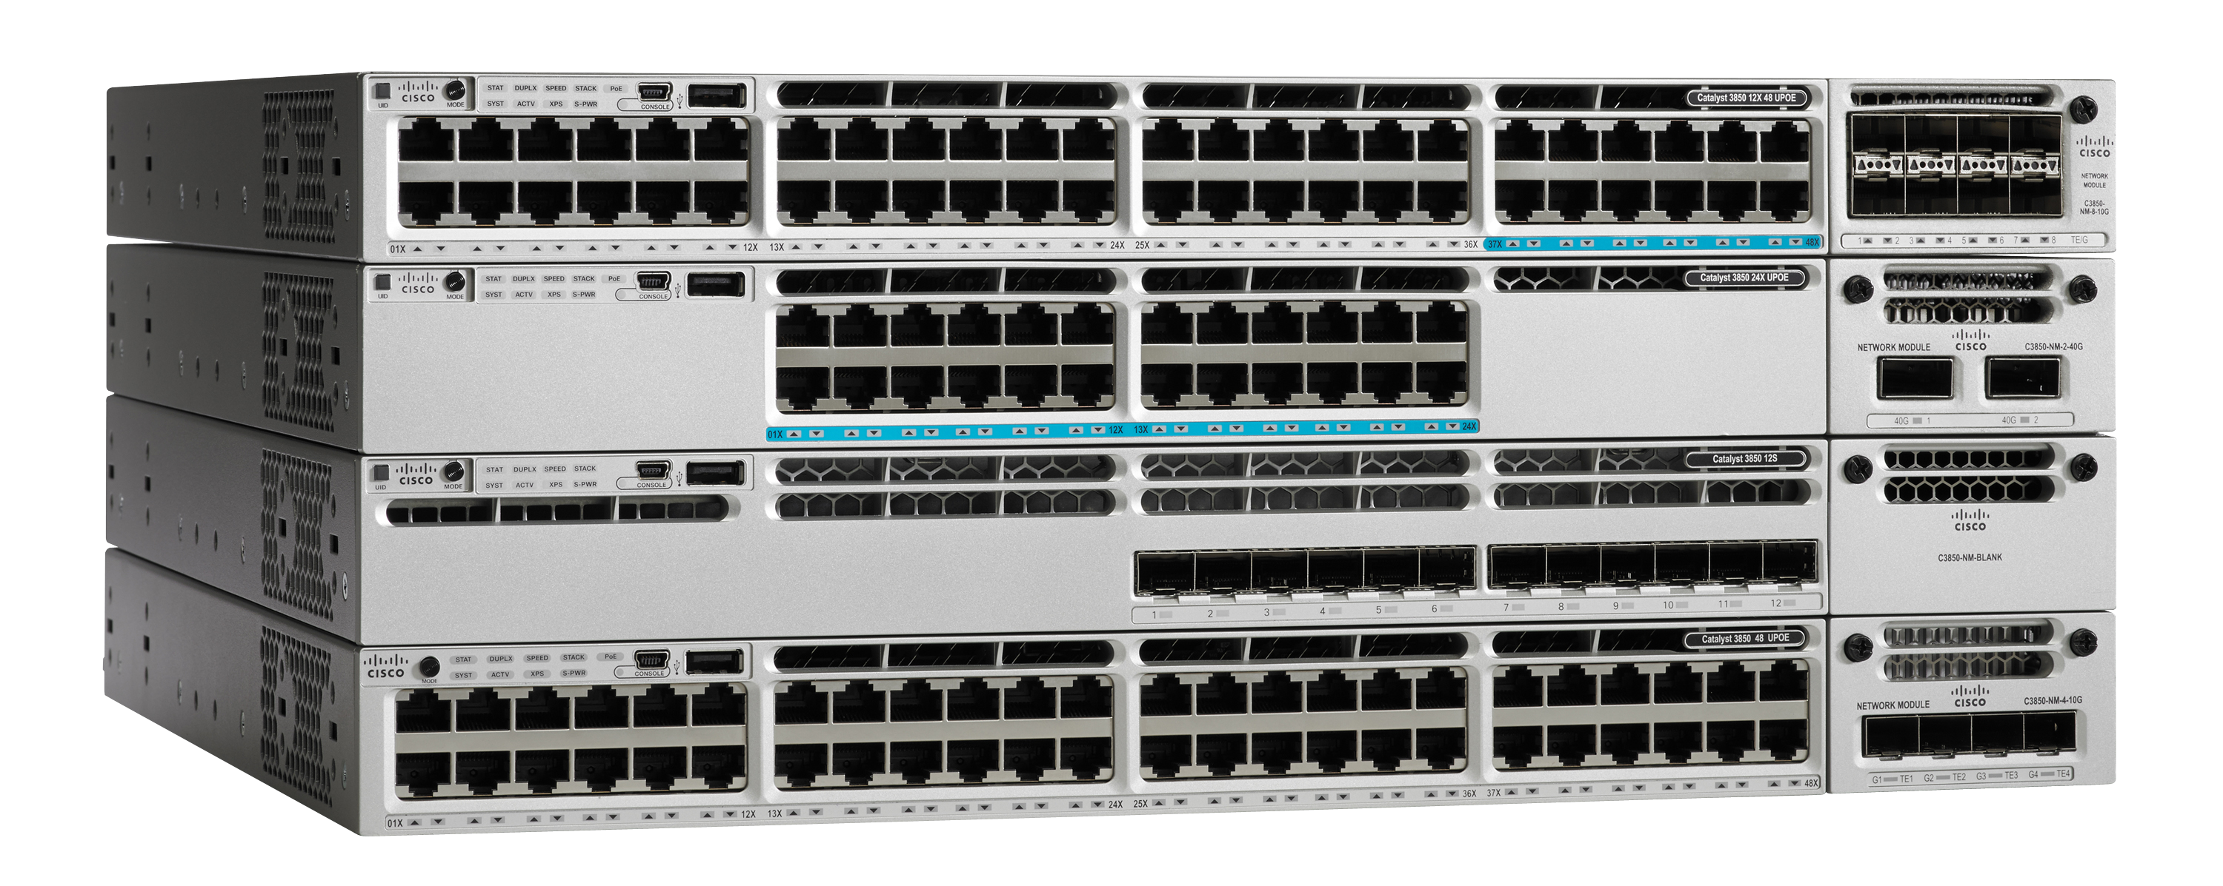
Switch Hardware
Port Density
The port density of a switch refers to the number of ports available on a single switch.
Fixed configuration switches support a variety of port density configurations. The Cisco Catalyst 3850 come in 12, 24, 48 port configurations.
Modular switches can support very high port densities through the addition of multiple switchport line cards. The modular Catalyst 9400 switch supports 384 switchport interfaces.
Notes:
11 – Network Design
11.3 – Switch Hardware
11.3.3 – Port Density

Slide 33
Switch Hardware
Forwarding Rates
Forwarding rates define the processing capabilities of a switch by rating how much data the switch can process per second.
Switch product lines are classified by forwarding rates.
Entry-level switches have lower forwarding rates than enterprise-level switches.
If switch forwarding rate is too low, it cannot accommodate full wire-speed communication across all of its switch ports.
Wire speed is the data rate that each Ethernet port on the switch is capable of attaining.
Data rates can be 100 Mbps, 1 Gbps, 10 Gbps, or 100 Gbps.
Access layer switches typically do not need to operate at full wire speed, because they are physically limited by their uplinks to the distribution layer.
Notes:
11 – Network Design
11.3 – Switch Hardware
11.3.4 – Forwarding Rates

Slide 34
Switch Hardware
Power over Ethernet
Power over Ethernet (PoE) allows the switch to deliver power to a device (e.g., IP phone, AP, camera) over the existing Ethernet cabling.
A network administrator should ensure that the PoE features are actually required for a given installation, because switches that support PoE are expensive.
Notes:
11 – Network Design
11.3 – Switch Hardware
11.3.5 – Power over Ethernet

Slide 35
Switch Hardware
Multilayer Switching
Multilayer switches are typically deployed in the core and distribution layers of an organization's switched network.
They support some routing protocols and forward IP packets at a rate close to that of Layer 2 forwarding.
Multilayer switches often support specialized hardware, such as application-specific integrated circuits (ASICs).
ASICs along with dedicated software data structures can streamline the forwarding of IP packets independent of the CPU.
Notes:
11 – Network Design
11.3 – Switch Hardware
11.3.6 – Multilayer Switching

Slide 36
Switch Hardware
Business Considerations for Switch Selection
Consideration | Description
Cost | The cost of a switch will depend on the number and speed of the interfaces, supported features, and expansion capability.
Port density | Network switches must support the appropriate number of devices on the network.
Power | It is now common to power access points, IP phones, and compact switches user Power over Ethernet (PoE). In addition to PoE considerations, some chassis-based switches support redundant power supplies.
Reliability | The switch should provide continuous access to the network.
Port speed | The speed of the network connection is of primary concern to end users.
Frame buffers | The ability of the switch to store frames is important in a network where there may be congested ports to servers or other areas of the network.
Scalability | The number of users on a network typically grows over time; therefore, the switch should provide the opportunity for growth.
Notes:
11 – Network Design
11.3 – Switch Hardware
11.3.7 – Business Considerations for Switch Selection
11.3.8 – Check Your Understanding - Switch Hardware

Slide 37
11.4 Router Hardware
Notes:
11 – Network Design
11.4 – Router Hardware

Slide 38
Router Hardware
Router Requirements
Routers use the network portion (prefix) of the destination IP address to route packets to the proper destination.
They select an alternate path if a link goes down.
All hosts on a network specify the IP address of the local router interface as their default gateway.
Routers also serve other beneficial functions as follows:
They provide broadcast containment by limiting broadcasts to the local network.
They interconnect geographically separated locations.
The group users logically by application or department within a company, who have command needs or require access to the same resources.
They provide enhanced security by filtering unwanted traffic through access control lists.
Notes:
11 – Network Design
11.4 – Router Hardware
11.4.1 – Router Requirements

Slide 39
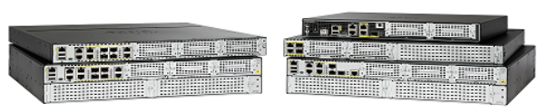
Router Hardware
Cisco Routers
Branch routers, shown in the figure, optimize branch services on a single platform while delivering an optimal application experience across branch and WAN infrastructures. Shown are the Cisco Integrated Services Router (ISR) 4000 Series Routers.
Notes:
11 – Network Design
11.4 – Router Hardware
11.4.2 – Cisco Routers

Slide 40
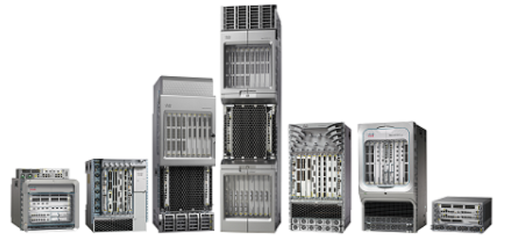
Router Hardware
Cisco Routers (Cont.)
Network edge routers, shown in the figure, enable the network edge to deliver high-performance, highly secure, and reliable services that unite campus, data center, and branch networks. Shown are the Cisco Aggregation Services Routers (ASR) 9000 Series Routers.
Notes:
11 – Network Design
11.4 – Router Hardware
11.4.2 – Cisco Routers

Slide 41
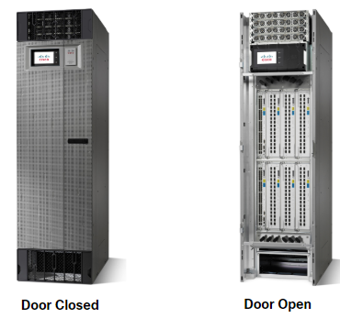
Router Hardware
Cisco Routers (Cont.)
Service provider routers, shown in the figure, deliver end-to-end scalable solutions and subscriber-aware services. Shown are the Cisco Network Convergence System (NCS) 6000 Series Routers.
Notes:
11 – Network Design
11.4 – Router Hardware
11.4.2 – Cisco Routers

Slide 42
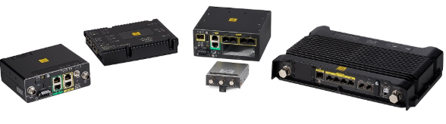
Router Hardware
Cisco Routers (Cont.)
Industrial routers, such as the ones shown in the figure, are designed to provide enterprise-class features in rugged and harsh environments. Shown are the Cisco 1100 Series Industrial Integrated Services Routers.
Notes:
11 – Network Design
11.4 – Router Hardware
11.4.2 – Cisco Routers

Slide 43
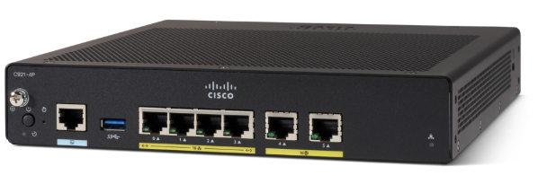
Router Hardware
Router Form Factors
Cisco 900 Series: This is a small branch office router. It combines WAN, switching, security, and advanced connectivity options in a compact, fanless platform for small and medium-sized businesses.
Notes:
11 – Network Design
11.4 – Router Hardware
11.4.3 – Router Form Factors
11.4.4 – Check Your Understanding - Router Hardware

Slide 44
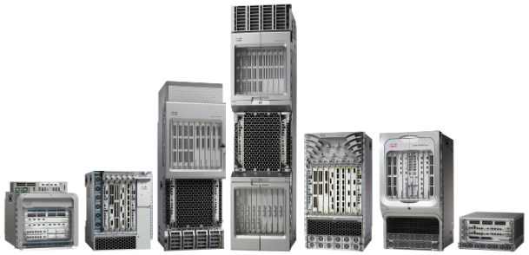
Router Hardware
Router Form Factors
Cisco ASR 9000 and 1000 Series Aggregation Services Routers: These routers provide density and resiliency with programmability, for a scalable network edge.
Notes:
11 – Network Design
11.4 – Router Hardware
11.4.3 – Router Form Factors
11.4.4 – Check Your Understanding - Router Hardware

Slide 45
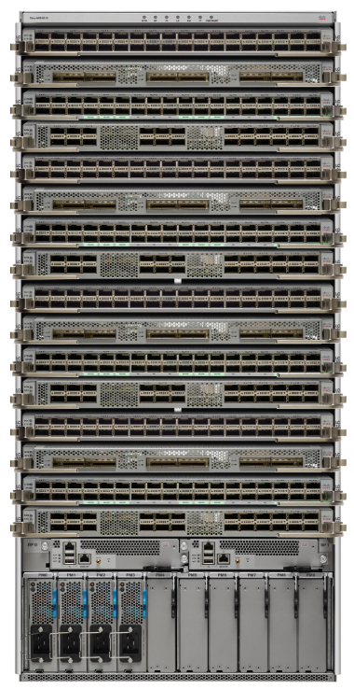
Router Hardware
Router Form Factors
Cisco Network Convergence System 5500 Series Routers: These routers are designed to efficiently scale between large data centers and large enterprise networks, web, and service provider WAN and aggregation networks.
Notes:
11 – Network Design
11.4 – Router Hardware
11.4.3 – Router Form Factors
11.4.4 – Check Your Understanding - Router Hardware

Slide 46
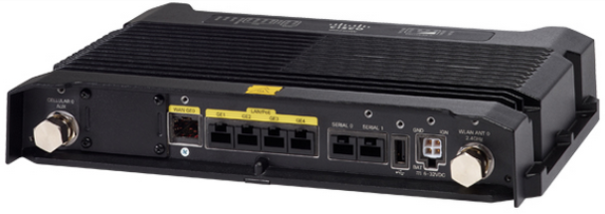
Router Hardware
Router Form Factors
Cisco 800 Industrial Integrated Services Router: This router is compact and designed for harsh environments.
Notes:
11 – Network Design
11.4 – Router Hardware
11.4.3 – Router Form Factors
11.4.4 – Check Your Understanding - Router Hardware

Slide 47
11.5 Module Practice and Quiz
Notes:
11 – Network Design
11.5 - Module Practice and Quiz

Slide 48
Module Practice and Quiz
Packet Tracer - Compare Layer 2 and Layer 3 Devices
In this Packet Tracer activity, you will use various commands to examine three different switching topologies and compare the similarities and differences between the 2960 and 3650 switches.
You will also compare the routing table of a 4321 router with that of a 3650 switch.
Notes:
11 – Network Design
11.5 - Module Practice and Quiz
11.5.1 – Packet Tracer – Compare Layer 2 and Layer 3 Devices

Slide 49
Module Practice and Quiz
What did I learn in this module?
The Cisco Borderless Network provides the framework to unify wired and wireless access, and is built on a hierarchical infrastructure of hardware that is scalable and resilient.
Two proven hierarchical design frameworks for campus networks are the three-tier layer and the two-tier layer models.
The three critical layers within these tiered designs are the access, distribution, and core layers.
Implement redundant links between critical devices and between access layer and core layer devices.
Implement multiple links between equipment, with either link aggregation (EtherChannel) or equal cost load balancing, to increase bandwidth.
Use a scalable routing protocol and implementing features to minimize the routing table size.
Implement wireless connectivity to allow for mobility and expansion.
Notes:
11 – Network Design
11.5 - Module Practice and Quiz
11.5.2 – What did I learn in this module?

Slide 50
Module Practice and Quiz
What did I learn in this module? (Cont.)
There are campus LAN, cloud-managed, data center, service provider, and virtual networking witches.
Form factors for switches include fixed configuration, modular configuration, and stack
Routers use the network portion (prefix) of the destination IP address to route packets to the proper destination.
Routers select an alternate path if a link or path goes down.
Cisco has several categories of routers including branch, network edge, service provider and industrial.
Notes:
11 – Network Design
11.5 - Module Practice and Quiz
11.5.2 – What did I learn in this module?

Slide 51
Module 11: Network Design
New Terms and Commands
Borderless Network Hierarchical Scalable Modular Resilient Flexible Three-tier model Two-tier model Access Layer Distribution Layer Core Layer EtherChannel Rack unit Power over Ethernet

